Slide 1
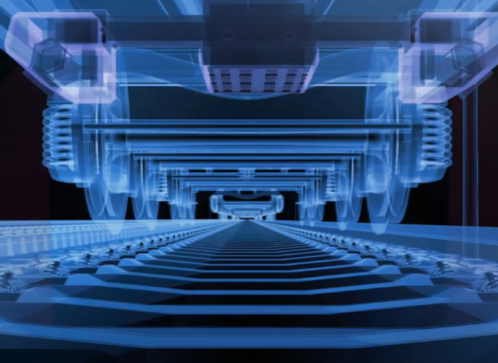
Continuous Track Monitoring (CTM)
Detect Early. Prevent Failures. Stay on Track.
The Challenge:
The future of rail mobility depends on achieving higher safety standards, better passenger comfort, shorter travel times, and improved punctuality – all while running more trains on aging infrastructure.
Our Solution:
CTM equips regular trains with robust, highly accurate measurement technology that autonomously records both track condition and travel comfort. By turning every journey into a source of valuable data, CTM enables the early detection of track damage and condition deterioration.
This allows infrastructure managers to plan proactive and predictive maintenance – ensuring smooth operations for vehicles, passengers, and infrastructure alike.
CTM keeps your railway operations running, safely and cost-effectively – today and in the future.
DB AG
Continuous Measurement & Data Collection: Regular trains become rolling inspection units, continuously gathering precise data on track condition and travel comfort without disrupting daily operations.
Condition Analysis: Collected data is processed and analyzed to deliver clear insights into infrastructure health, enabling an objective and up-to-date picture of track performance.
Predictive Maintenance Support: Early trend detection allows operators to plan ahead, addressing issues before they cause costly disruptions or safety concerns.
Integration & Reporting: Intuitive reporting tools and seamless integration with existing systems ensure maintenance teams receive actionable insights quickly and effectively.
Efficient and Predictable Railway Operations: Temporary speed reductions and delays can spread through a network, causing disruptions. With CTM, issues are identified long before they impact operations, keeping traffic flowing smoothly and timetables reliable for both freight and passenger services.
Optimized Track Maintenance: CTM delivers a continuous stream of track data instead of occasional inspection results. Managers can prioritize interventions based on real conditions, allocate resources more effectively, and extend asset lifetime through targeted, cost-efficient maintenance.
Higher Safety: CTM detects critical issues such as damaged sleepers or unstable track beds early and sends timely warnings to maintenance teams. This prevents accidents, protects passengers, and secures infrastructure investments.
Dr. Jörg Heland
Joerg.Heland@deutschebahn.com
+49 160-974 33449

